Slide 1
Why to automate
Internationalization & Localization
Web Browser Error
Cross Browser Testing
Cross Browser Testing Tools

Slide 2
Why to automate
What to automate?
Regression Tests: Stabilized tests that verify stabilized functionality
Tests rerun often: Tests that are executed regularly vs. rarely(repeated)
Tests that will not expire shortly: Most tests have a finite lifetime during which its automated script must recoup the additional cost required for its automation
Tedious/Boring tests:
tests with many calculations and number verifications
repetitive tests performing the same operations over and over
tests requiring many performance measurements
Just plain boring tests
Reliably repeatable

Slide 3
Internationalization & Localization

Slide 4
Internationalization & Localization
Internationalization testing is to ensure that application can function in any culture or local (language, territory and code page) It is also called as Globalization Testing. Globalization Testing. ... Globalization testing checks proper functionality of the product, using every type of international input possible
Localization testing is the software testing process for checking the localized version of a product for that particular culture or locale settings. The areas affected by localization testing are UI and content.

Slide 5
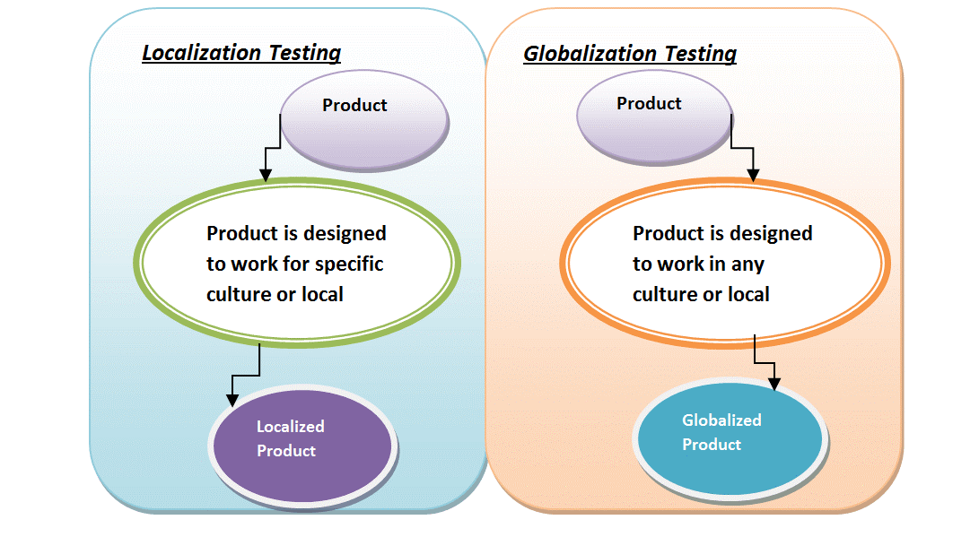
Internationalization & Localization

Slide 6
Internationalization & Localization
Internationalization Testing | Localization Testing
Globalization focuses your applications capabilities on users as generic user base. | Localization focuses on subset of users in a given culture or locale.
Separation of testers from translators and engineers, ensuring a thorough and impartial approach. | It helps reduce time for testing since its done for just on locale
Detect potential problems in application design that could inhibit globalization | Validation of all application resources
It ensures that without breaking functionality code can handle all international support | Verification of linguistic accuracy and resource attributes. Check Typographical errors

Slide 7
Web Browser Error
Common browser error messages such as 404, 500. Read information about the most common error messages you might see while using the internet. ... This error is similar to 401 in that it's likely to be a username or password issue. Alternatively, the site's administrator may have restricted access to this page.

Slide 8
Web Browser Error - Types
Certificate Error
Phishing and Malware Warnings
404 Not Found
Customized Error Pages
Server Not Found
Unable to Connect

Slide 9
Cross Browser Testing
Cross Browser Testing is a process to test web applications across multiple browsers. Cross browser testing involves checking compatibility of your application across multiple web browsers and ensures that your web application works correctly across different web browsers.
Cross Browser Testing can be the biggest pain for Software testers. But thanks to all cross browser testing tools available online which help to minimize testing efforts.

Slide 10
Cross Browser Testing - Tools
Browsershots
Browser Sandbox
IE Testers
Webshot by Mobile Ready
Browsera
CrossBrowserTesting
BrowserStack

Slide 11
Cross Browser Testing - Tools
Browsershots is a simple and very useful tool. It’s a free tool but it does provide functionalities you won’t find in any other tool, paid ones included.
The service is just a screenshot of how a site looks like in a range of browsers. However, the list of supported browsers is huge. You can also select the screen size, color depth, whether to check or not for issues with JavaScript (and which JavaScript version), Java and Flash.

Slide 12
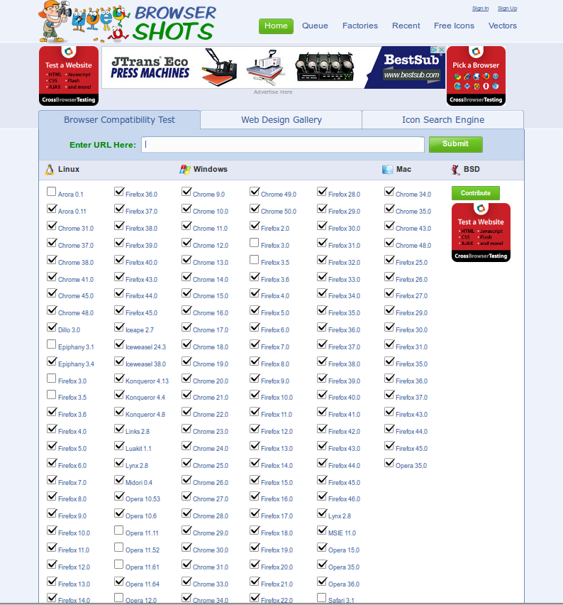
Cross Browser Testing - Tools
Browsershots

Slide 13
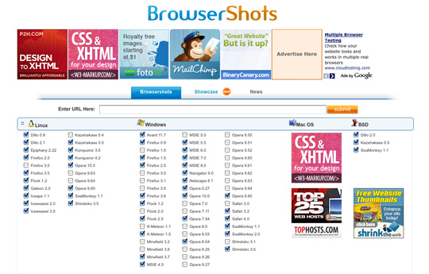
Cross Browser Testing - Tools

Slide 14
Cross Browser Testing - Tools
Browsershots allow you to test website in any browser and operating system. This is widely used cross browser testing tool because of its features and available customizations.
You can run cross browser compatibility tests with great customization options like browser type, operating system, screen size, colour depth, JavaScript status and Flash enable/disable settings. Just put your website url, select compatibility test parameters and submit the test request.
You need to repeat the steps for every test. This free browser compatibility test service can be used for taking website screen-shots almost in 61 browsers and various operating systems.
Main drawback of this service is the time taken to display the result when you select many browsers and many times it shows timeout error.
Supported browsers: IE, Firefox, Google Chrome, Opera, Safari, Minefield, Netscape and many more browsers with all versions.

